Slide 1

ARTIFICIAL INTELLIGENCE PROJECT PROPOSAL
TOPIC: LED Controller
GROUP MEMBERS:
SYED RAFAY ZAIN (B19102145)
HAMZA EJAZ (B19102041)
BILAL HASSAN (B19102030)
USMAN JILANI (B19102155)

Slide 2

LED Controller
LED controllers are a critical part of any dynamic lighting control system. Controllers are used to change colors for RGBW and RGB LED lights. They are also used to change and select color temperatures with color temperature changing CCT LED strips and dim single-color, white LED strips to varying light levels.

Slide 3

METHOD
The LED circuit is built around an Arduino Uno board, in which we use webcam to take input from user with the help of hand. It will work in a way that one finger is open then 1 LED will appear to be open which will be followed by the next four fingers to open the other four lights.

Slide 4
BENIFICIARIES
Hotels where we can use this system.
Disabled person(s) who need help from others for such minimal tasks

Slide 5
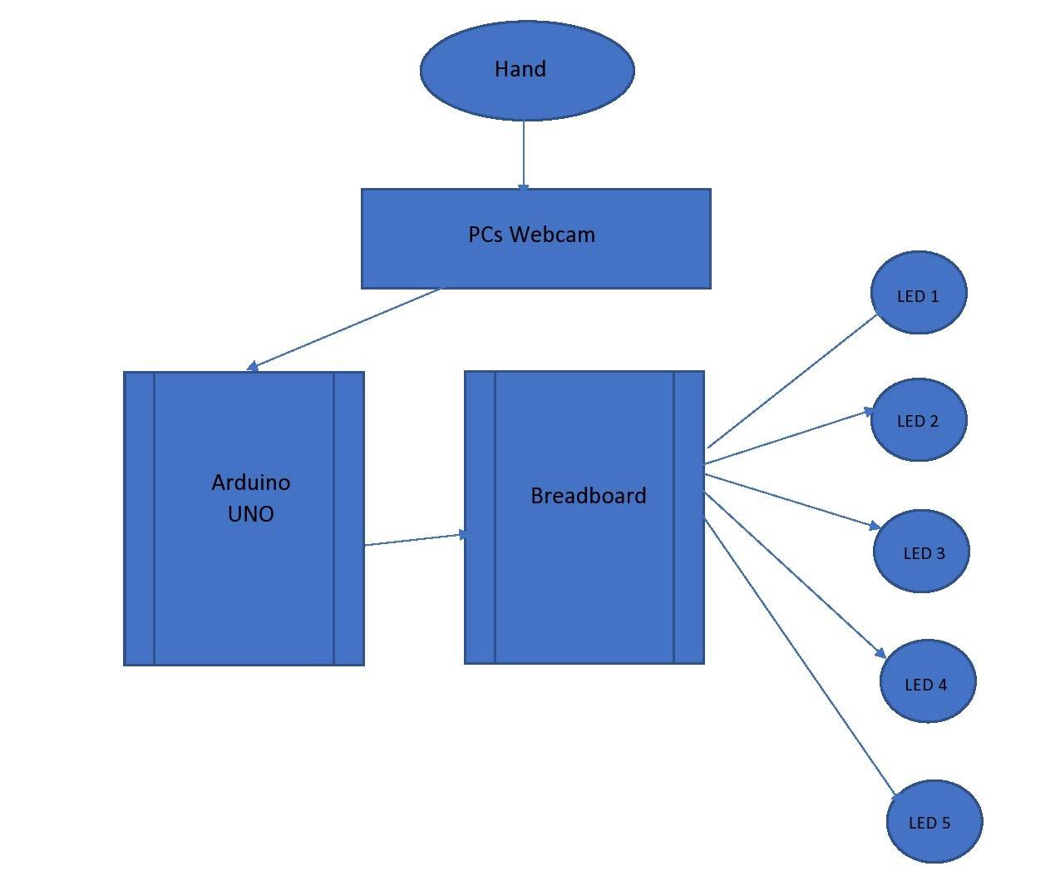
BLOCK DIAGRAM

Slide 6
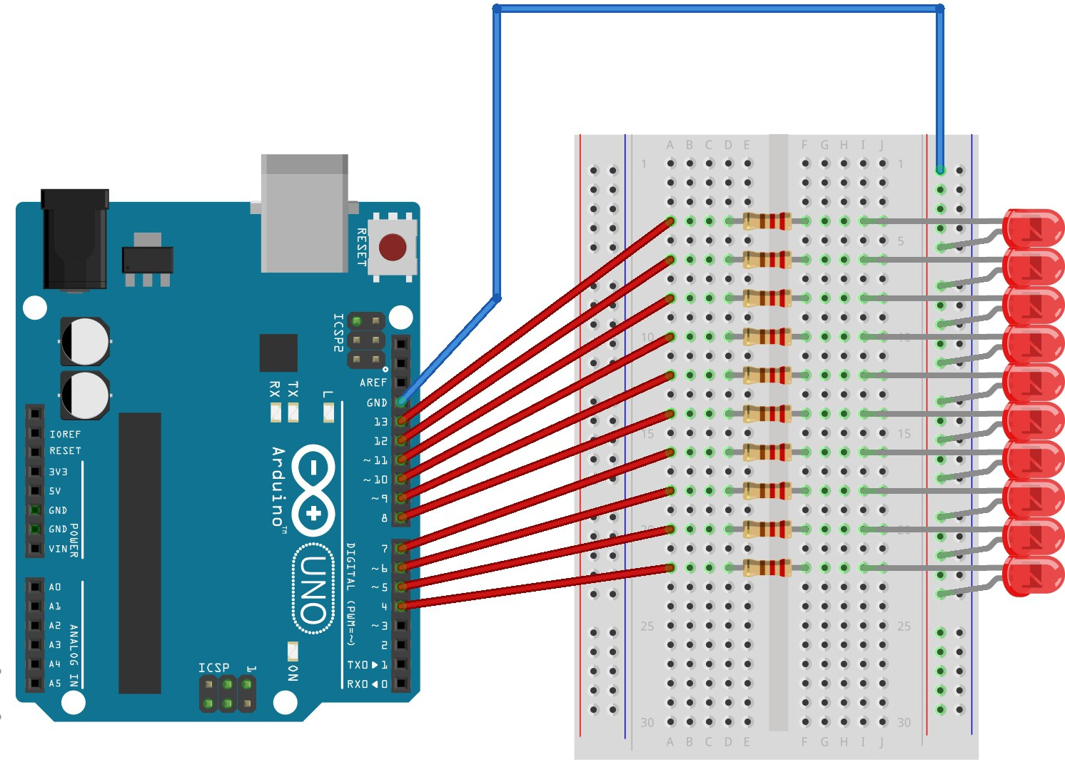
PROTOTYPE

Slide 7
TECHNOLOGY REQUIRED
Arduino-Compatible UNO R3
Breadboard
5 x 5mm LED
1 x USB Connector
6 x Jump Wire

